Slide 1
DEPARTMENT OF Electronics and communication Engineering
PROJECT TITLE
VOICE CONTROLLED CAR USING ARDUINO
ROHAN N KALPAVRUKSHA PES1201802830
ROSHAN N KALPAVRUKSHA PES1201802834
mohAMMED ASHIQ Pes1201801893

Slide 2
ABSTRACT
This project builds a voice controlled car that can be controlled by voice commands and it conveniently reacts to corresponding voice command.
It uses an android mobile for voice recognition and through Bluetooth the info reaches the hardware and acts accordingly.
We would also improve the scope by including sensors for the car to stop in case of an obstacle even without the interference of voice.

Slide 3
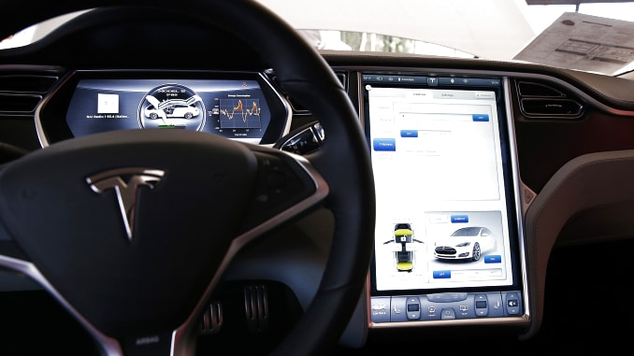
MOTIVATION
This can be used in places where humans find it difficult to reach but voice can reach.Eg-small pipeline,fire situations,toxic areas.
This car can reduce man effort in this busy traffic world and reduce accidents.
This car can be used by limb disabled people.
This can replace our fuel based cars.

Slide 4
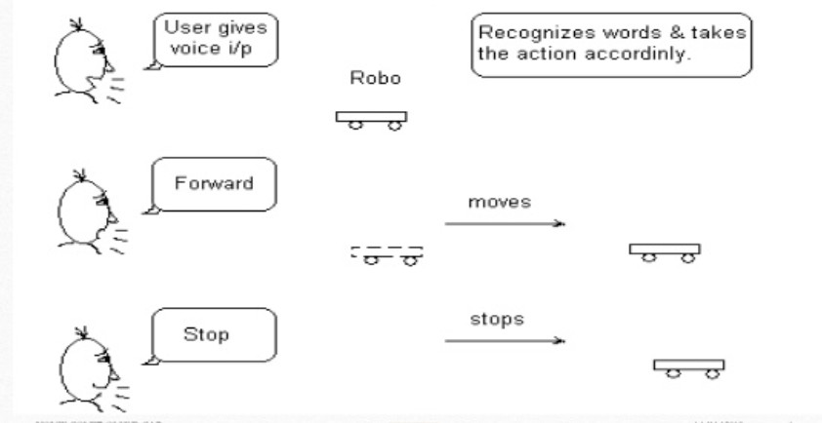
METHODOLOGY
Voice
Input
Forward , Back
Stop
Arduino
Program is coded and run on the laptop
Motors behave accordingly
Sensors
With help of servo and ultrasonic sensors
Can sense obstacles
Left ,Right
Code is dumped into it through usb cable
Dance

Slide 5
BLOCK DIAGRAM
Bluetooth
Android App Device
Transmitter
Receiver
Arduino
UNO
Motor 1
Motor 2
Motor 3
Motor 4
Bluetooth Device
Motor Driver
Power supply to all

Slide 6
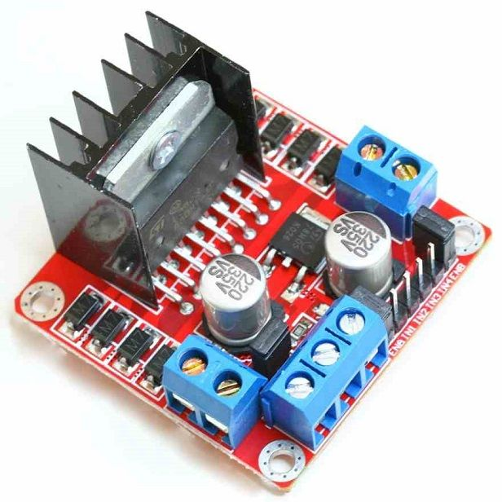
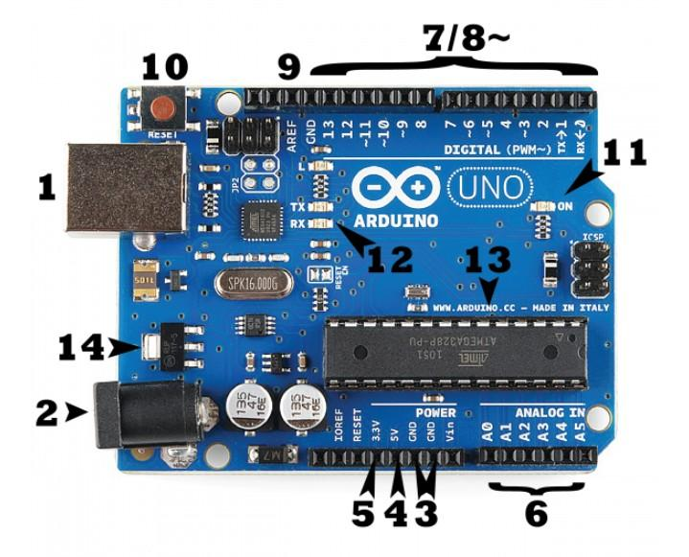
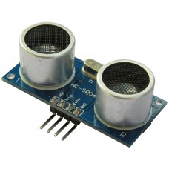
THEORY
When we say voice control, the first term that needs to be considered is Speech Recognition.
Speech recognition circuit (SRC) is programmable. You can program and train the SRC to recognize the unique words you want to use.
These commands are given to Bluetooth module and received via android application(BT voice control) .The integration of control unit with Bluetooth device is done to capture and read voice command via android application.
The vehicle operates as per the command received with the help of Arduino(motors , wheel).

Slide 7
STUDY ON WHAT IS ARDUINO
Arduino is an open source platform used for building electronics projects.
Arduino consists of
Physical programmable circuit board
Software /IDE –to write and upload code to physical board
We can simply use a usb cable to load the code to the board
It uses a simplified version of c++
The uno is a popular board family of Arduino for beginners

Slide 8
{1}-Arduino’s Power source
{2}-Barrel Jack
{3}-Ground
{4},{5}-5V&3.3V
{6}-Analog input that will be converted to digital
{7}-Digital Input and Output
{8}~-Pulse Width Modulation
{9}-Analog Reference
{10}-Reset Button
{11}-Power LED indicator
{13}-Main IC (Brain of Arduino)
{14}-Voltage Regulator
HC 05 BT Module –Bluetooth sensor
L298N Module-To control the speed and direction of DC Motors
Motors and wheels –Movement of car
Male and Female Jumpers-For connections
12V Battery

Slide 9
RESULT
A CAR THAT WORKS ON VOICE COMMAND AND SENSORS PROVIDE COMFORTABLE ,SAFE DRIVING FACILITY
Command | Front-left | Front-right | Back-Left | Back-Right
Forward | H | H | H | H
Back | L | L | H | H
Left | LH | HH | LH | LH
Right | HH | LH | LH | LH
Stop | L | L | L | L

Slide 10
CONCLUSION ,FUTURE SCOPE
Work has been restricted to short range module ,use of long range modules can result in connectivity with the car for long distances.
Camera can be installed to the mini car to capture images from man restricted areas.
Automatic Targeting system can be implemented in the robot for tracking the target.

Slide 11
BLOCK DIAGRAM

Slide 12
REFERENCES
www.arduino.org
www.beyondlogic.org
https://create.arduino.cc
www.wikipedia.org
www.slideshare.net

Slide 13
THANK YOU

